Slide 1
Webinar 7 – Human Resources Management
Human Resources Management in the XXI Century
September 7, 2023

Slide 2
Webinar 7
Human Resources Management in the XXI Century
No Webinar 7, will be presented some principles of Human Resource Management in the twenty-first century, seeking to enable each trainee to: Understand that human resources include multiple phases of recruitment Identify how to make these phases more inclusive Equip participants with practical tools they can apply to a more inclusive workplace

Slide 3
Webinar 7
Learning outcomes
Understand that recruitment is more difficult for certain social groups than for others due to discriminatory prejudices;
Learn about tools and resources to help participants implement inclusive human resources policies;
Understand that the recruitment process consists of several phases;
Be able to implement practices to make the recruitment process more inclusive.

Slide 4
Content
Human Resources Management 5 Phases of Recruitment Paradigms of the XXI Century Strategic agility Entrepreneurial team and strategic agility Guest Presentation Q&A with the Guest

Slide 5
Webinar 7 Human Resources Management in the XXI Century

Slide 6
Human Resources Management in the XXI Century
Sustainable Human Resource Management
Human Resource Management is the strategic administration of HR responsible for aligning organizational objectives with the satisfaction of a company's employees. HR management uses different techniques of People Management and Administration to achieve this purpose.
(Dias, 2023)

Slide 7
Human Resources Management in the XXI Century
The 5 phases of recruitment
1
Prepare the Recruitment Process Recruitment teams aligned with the strategy and values of inclusion
3
Onboarding Integrate the person in the Culture, Mission, Values and Objectives of the company and provide him with the fundamental tools for his integration.
5
Output The conduct of an interview at the time of the worker's departure
2
Recruitment and Selection Find the professionals who best fit the required profile
4
Accompaniment Monitoring adjusted to your needs, interests and potential of the employee
Fonte: APPDI - Guia para um recrutamento inclusivo

Slide 8
Recruitment
Prepare the Recruitment Process
01
Assess the diversity of the organization Create a diagnosis of the organization and create an action plan to foster a culture of inclusion
02
Collaborative process In addition to HR, involve other departments and, if possible, some of the heads of the organization
03
Training in the area of diversity Enroll employees in training in the area of diversity
04
Establish partnerships with specialized entities Ensure an effective training offer and specialized consulting services at this stage of the process
Fonte: APPDI - Guia para um recrutamento inclusivo

Slide 9
Recruitment
Recruitment and Selection
Identification of the need Identify the need for hiring, weighing the gaps in the company's diversity
01
Job description Present the role as clearly and accurately as possible, specifying the roles and requirements of the position you are applying for and the desired profile
02
Sources of recruitment Make sure you have access to a diverse range of candidates and that the position attracts a diverse audience
03
Application Analysis Create an "out of the box" scoring system and try to make sure you have people with different backgrounds at this stage
04
Fonte: APPDI - Guia para um recrutamento inclusivo

Slide 10
Recruitment
Recruitment and Selection Process
Interview It is necessary to pay attention to some aspects of the interview in an inclusive selection process Pay special attention to your unconscious biases Learn more about the accessibility needs of selected people Ensure that everyone has the same opportunities to demonstrate their skills
05
Selection Transparent, objective and fair decisions Involve more people in decision making Know well the position and the function that it requires Consider whether additional training is needed Verify that the company has adequate facilities
06
Fonte: APPDI - Guia para um recrutamento inclusivo

Slide 11
Recruitment
Recruitment and Selection
How can this function be performed by a person with a different background/profile than we normally ask for?
?
What kind of (new) customers do you want to reach and what characteristics can the new employee bring that would be an asset to understand their needs?
?
Ask in the organization if there are people with interest before launching the vacancy externally? Are there already people within the organization who could fill this role by getting some extra training?
?
Fonte: APPDI - Guia para um recrutamento inclusivo

Slide 12
Recruitment and selection
Onboarding
01
Communicate to the person who was selected General information and allocation of an internal mentor
Prepare for the person's entry into the organization Introduce the employee and develop awareness of the organization and the team
02
Welcome Ensure that the person is received by the mentor and inform them about the culture and logistics of the organization
03
Integration Do the constant monitoring and make sure that the company can make the necessary adjustments. Foster the connection between the various employees.
04
Fonte: APPDI - Guia para um recrutamento inclusivo

Slide 13
Recruitment and selection
Accompaniment
01
Specialized Entity Assess the relevance of expert monitoring by an external entity
02
Follow-up Plan Define with the employee the monitoring and career plans
Mentor Evaluate mentor and mentee feedback on the experience and make adjustments if necessary
03
Performance Evaluation Evaluate the career plan, invite the employee to self-evaluate, make your performance evaluation and analyze them together, clearly defining the objectives and actions to be developed to achieve them.
04
Fonte: APPDI - Guia para um recrutamento inclusivo

Slide 14
Recruitment and selection
Output
01
Interview Conduct an exit interview with the employee to improve your D&I strategy and transform your organization into an inclusive workplace.
02
Choose the interviewer Someone experienced in the topic of diversity and inclusion. Make sure the employee is available.
Avoid asking questions about specific people
Overly personal questions about leaving
Data processing Use the information collected in the interview to change, if necessary, your D&I policy
03
Fonte: APPDI - Guia para um recrutamento inclusivo

Slide 15
ACTIVITY
IDENTIFIES ELEMENTS AND STRATEGIES FOR AN INCLUSIVE RECRUITMENT PROCESS

Slide 16
Human Resources Management in the XXI Century
Attention Deficit Hyperactivity Disorder (ADHD)
Acquired Blindness
What is it:
It is defined as the absence of visual perception caused by a defect of the eyeball and/or neurological. In a legal perspective, blindness exists when the best eye has a visual acuity of less than 1/10 and/or the visual field is less than 10º.
Symptoms
In acquired blindness, the individual has all the visual heritage prior to blindness and, therefore, there is the ability to represent an object or an environment by analogy
What is it:
It is a disorder in the neurodevelopment of the child that manifests itself between 6 and 12 years and can last until adulthood. This disorder affects brain development and function, notably the nervous system.
Symptoms
Difficulty concentrating Difficulty completing tasks (poor executive skills) Restlessness Mood Swings and Impatience

Slide 17
Paradigms of Human Resource Management in the twenty-first century

Slide 18
Human Resources Management in the XXI Century
Sustainable Human Resource Management
While different terms attempt to reconcile economic competitiveness, positive human/social outcomes, and ecological outcomes, they all recognize the impact of HR outcomes on the success and survival of the organization.
They also recognize the human and social outcomes of the organization, explicitly or implicitly. (R. Kramar, 2013)

Slide 19
Human Resources Management in the XXI Century
Ecological Management of Human Resources
Companies are increasingly aware of the importance of adopting environmentally friendly practices. With globalization, there is a shift to a capacity-based economy that exploits ecological economic facets.
Ecological human resource management (GHRM) has become a key business strategy for organizations, where HR departments actively participate in the implementation of green practices in the workplace.(S. Ahmad, 2015)

Slide 20
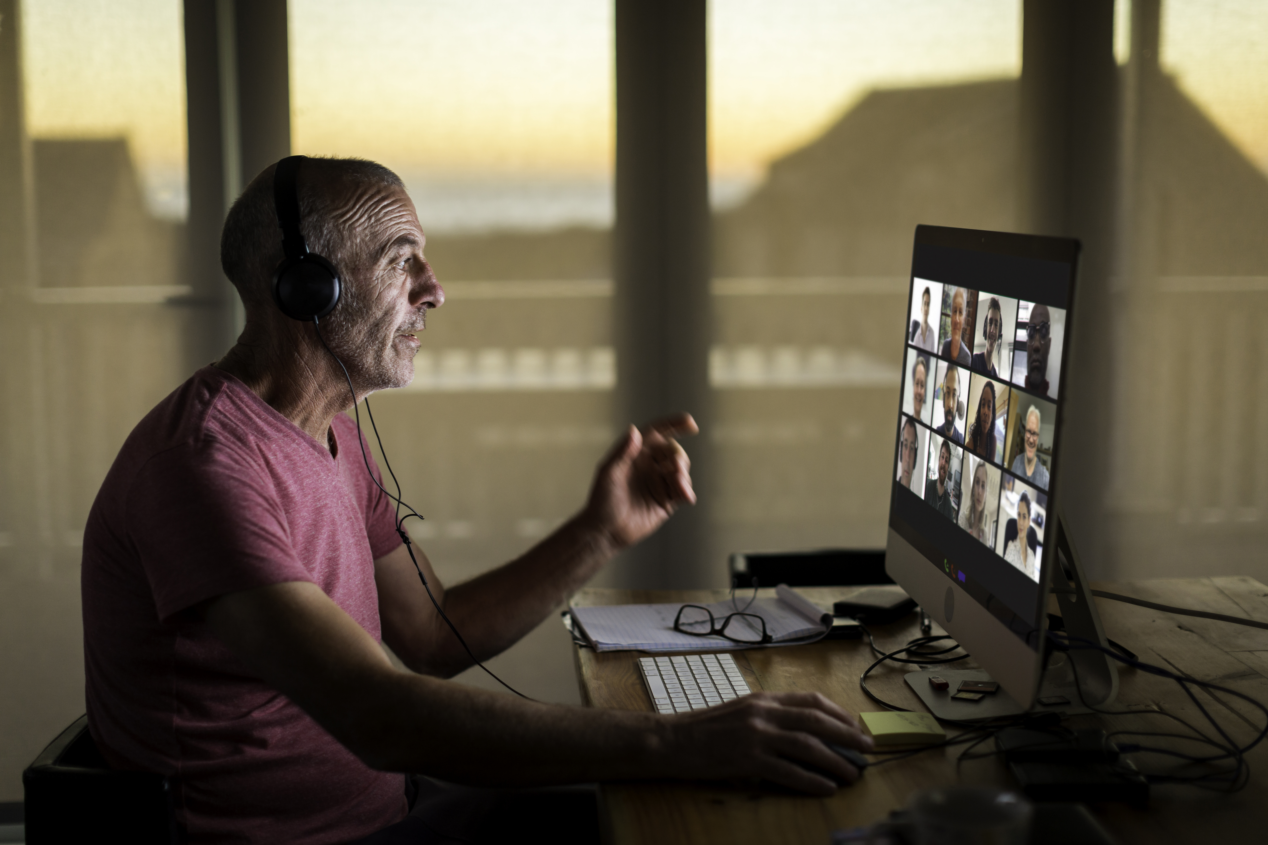
Human Resources Management in the XXI Century
Impact of Digital Transformation
One of the main changes promoted by the digital transformation in recruitment and selection is the way vacancies are advertised. Now, with the advent of social media, job sites and online recruitment platforms, it is possible to reach a much larger number of candidates in a short period of time.
(Lira, I, 2023)

Slide 21
Human Resources Management in the XXI Century
Paradigms
Sustainable human resource management
Reconciling economic competitiveness, positive human/social results and results Success and survival of the organization
Ecological Management of Human Resources
Implementation of ecological practices in the workplace Hiring professionals who are already familiar with sustainable processes
Impact of Digital Transformation
Vacancies are disclosed Social networks, job sites and recruitment platforms

Slide 22
EXEMPLES
Zappos (E-commerce) - Organizational culture in a holistic management approach, where they value employee satisfaction and happiness at work
Patagonia (Outdoor clothing) - Philosophy of "family management" offering a number of unique benefits, including flexible schedules, generous parental leave and support for volunteer activities.
Netflix (streaming entertainment) - Model of "freedom and responsibility", where employees have autonomy to make decisions and are responsible for their results.
Google (Technology) – Rigorous recruitment process, employee development programs, and unique approach to talent retention. It also highlights how the company promotes an inclusive and diverse work culture.
Southwest Airlines (airline) - Focus on hiring people with compatible values, employee training and development, and recognition programs. It also highlights how the company promotes a positive work environment and a culture of teamwork.

Slide 23
DEBATE
WHAT IS THE BEST COMPANY TO WORK FOR?

Slide 24
Human Resources Management in the XXI Century
Strategic agility and human resource management
The ability to adapt to dynamic changes in the external business environment is known as strategic agility.
With increasing changes in the contemporary business environment, agility has become a means of continually adjusting to external threats and opportunities.
(Ahammad et al., 2019)

Slide 25
Human Resources Management in the XXI Century
Strategic agility
Adjust quickly to challenges and maintain a competitive advantage.
Continuous and rapid collection and use of information
Rapid response to market changes
Controlling market uncertainty and risk
Strategic coherence
Responsiveness and competitive agility
(Ahammad et al., 2019)

Slide 26
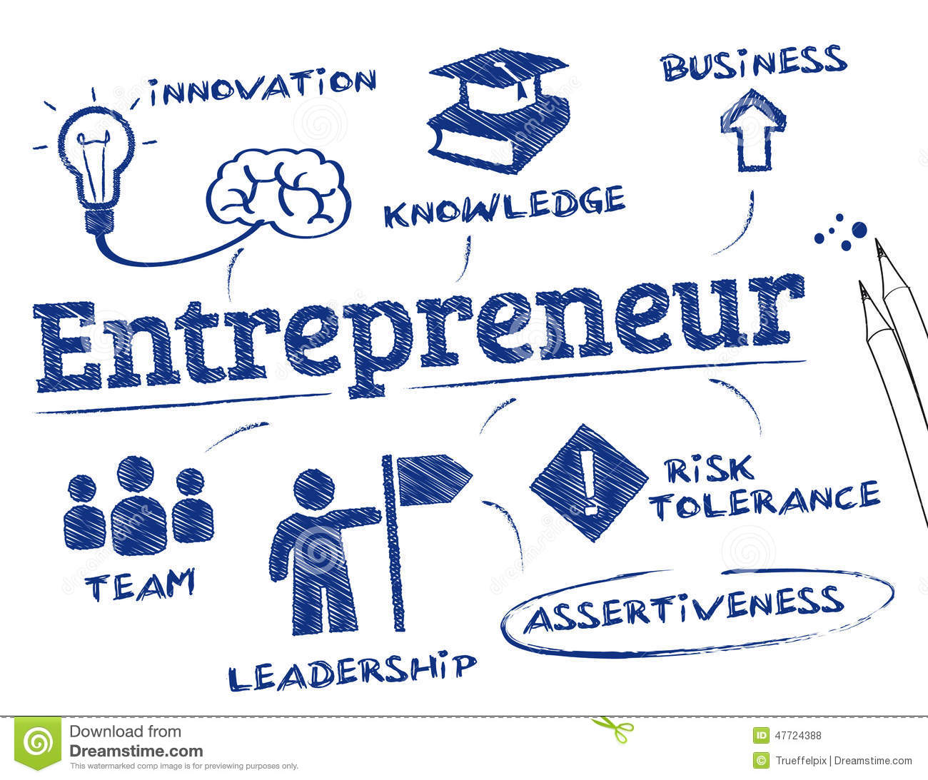
Human Resources Management in the XXI Century
Entrepreneurial team and strategic agility
Conceptual framework that connects the entrepreneurial team and strategic agility through the notion of dynamics around opportunism and speed of decision-making.
(Xing et al., 2019)

Slide 27
Human Resources Management in the XXI Century
Entrepreneurial team and strategic agility
The framework emphasizes the interconnectedness and dynamics between the three dimensions of the entrepreneurial team and the three dimensions of strategic agility, while recognizing that relationships can be complex and subtle. Relationships are moderated by the dynamics of opportunities and the speed of decision-making around them.
(Xing et al., 2019)

Slide 28
Human Resources Management in the XXI Century
A conceptual framework on the business team and strategic agility
Knowledge of Entrepreneurship
Opportunity
Speed
Strategic sensitivity
Training/team composition
Resource fluidity
Team Identity
Leadership Unit
(Xing et al., 2019)

Slide 29
Bibliography
Ahammad, M. F., Glaister, K. W., & Gomes, E. (2020). Strategic agility and human resource management. Human Resource Management Review, 30(1), 100700.
Ahmad, S. (2015). Green human resource management: Policies and practices. Cogent business & management, 2(1), 1030817.
Cunha, M. P., Gomes, E., Mellahi, K., Miner, A. S., & Rego, A. (2020). Strategic agility through improvisational capabilities: Implications for a paradox-sensitive HRM. Human Resource Management Review, 30(1), 100695.
Kramar, R. (2014). Beyond strategic human resource management: is sustainable human resource management the next approach?. The international journal of human resource management, 25(8), 1069-1089.
Xing, Y., Liu, Y., Boojihawon, D. K., & Tarba, S. (2020). Entrepreneurial team and strategic agility: A conceptual framework and research agenda. Human Resource Management Review, 30(1), 100696.

Slide 30
Partnership

